Slide 1
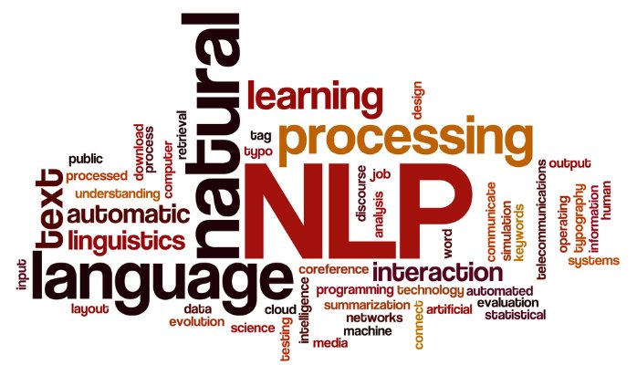
NLP Tasks and Methods
Dr. Ignatius Ezeani
Tuesday, 23 February 2021
Notes:
Hello every one, Welcome to the 2nd lecture from the NLP part of this module SCC.413.
In this lecture, we will

Slide 2

Lecture Outline
This lecture is structured in three parts:
Part 1:
Why NLP? What is it?
Why is it hard?
Part 2
Some common NLP Problems
Approaches to solving them
Part 3
Machine Learning for NLP
Extracting feature from text

Slide 3

Intended Learning Outcomes
At the end of this lecture, you should be able to
explain what NLP is and why it is hard
discuss some common NLP problems and approaches to solving them
explain how machine learning methods are used for NLP problems
discuss methods feature extraction from texts

Slide 4

What is NLP and why do we need it?

Slide 5
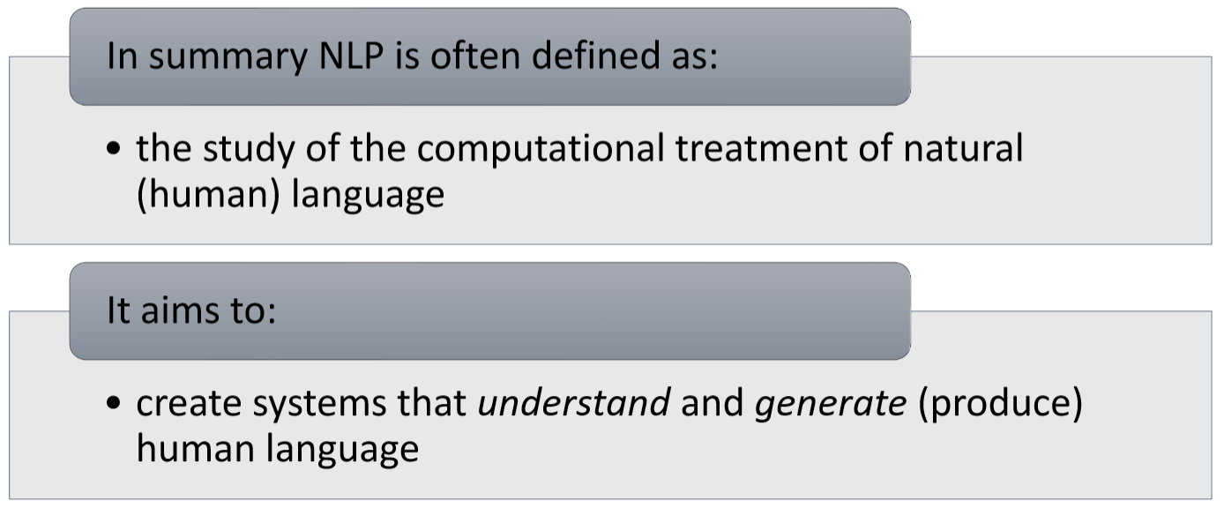
What is NLP?

Slide 6
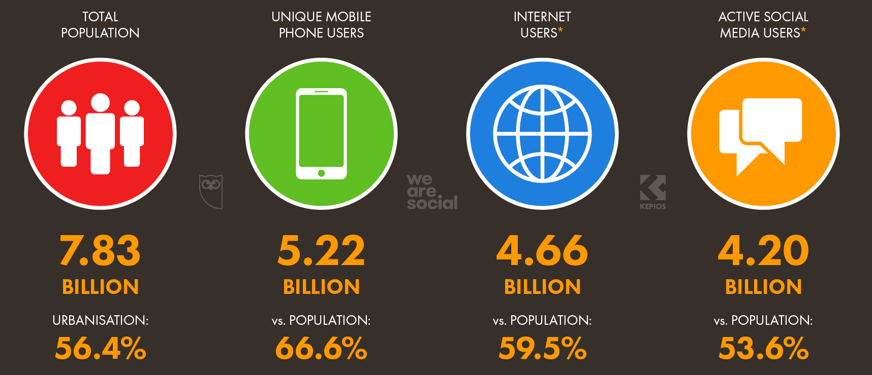
Who is on the internet?
By the end of Jan 2021
7.83bn people on earth
5.22bn mobile phone were active
4.91bn by end of 2017
4.66bn people were online
3.8bn by end of 2017
4.20bn social media users
https://www.nodegraph.se/how-much-data-is-on-the-internet/

Slide 7
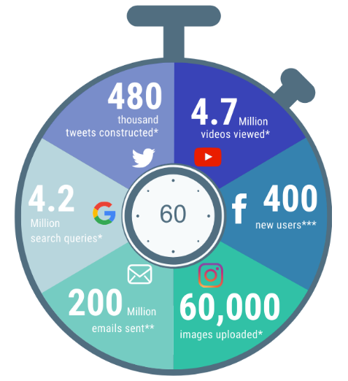
What happens every minute?
Every 60 seconds… 2020 vs 2017
 | 2020 | 2017
Emails sent | 200 million | 150 million
Google searches | 4.2 million | 3.8 million
Tweets sent | 480,000 | 448,800
Instagram images | 60,000 | 66,000
YouTube video | 4.7 million | 4.4 million
Facebook new users | 400 | 360
https://www.nodegraph.se/how-much-data-is-on-the-internet/

Slide 8

How much data has the internet?
2.7 Zb in 2017
4.4 Zb by end of 2019
44 Zettabytes (Zb) in 2020
175 Zb by end of 2025
A gigabyte is 1,024 megabytes
A terabyte is 1,024 gigabytes
A petabyte is 1,024 terabytes
An exabyte is 1,024 petabytes
A zettabyte is 1,024 exabytes
Putting that in context
1Zb = 1,024 exabytes,
1Zb = 1,048,576 pb,
1Zb = 1,073,741,824 tb,
1Zb = 1,099,511,627,776 gb,
1Zb = 1,125,899,910,000,000 mb!

Slide 9

How much data has the internet?
175 Zettabytes!
If on DVDs, the stack of DVDs would be long enough to circle the Earth 222 times!
If download at the average current internet connection speed, it would take you 1.8 billion years to download!

Slide 10
Why Natural Language Processing
Our devices are now part of our lives and we often cannot function without them.
We generate tonnes of human language data everyday and we desire to know what the data is telling us, sometimes in real-time.
We need tools and techniques to process the enormous amount of data on the internet and communicate outputs to us in human language
That’s why we need natural language processing techniques to create these tools

Slide 11
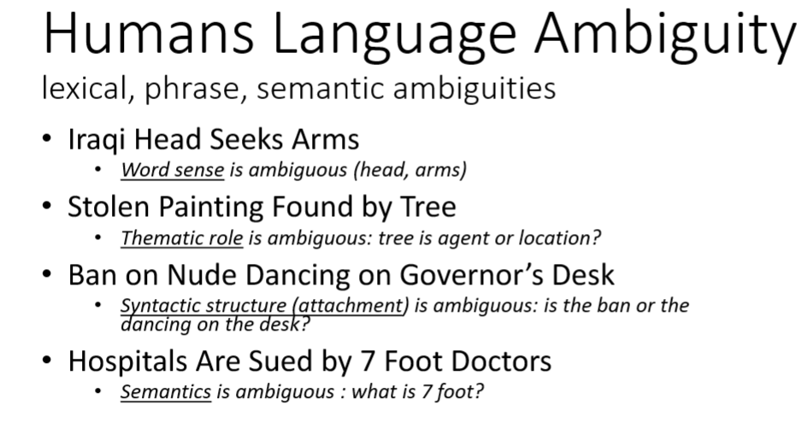

Why is NLP hard?

Slide 12
Why is NLP hard?
Language is subtle.
Similar the contexts may not guarantee
He arrived at the lecture
He chuckled at the lecture
He chuckled his way through the lecture
**He arrived his way through the lecture

Slide 13
Why is NLP hard?
Language is representation is unique
There is no known universal representation, parsing rules are flexible.
Language could be domain-specific e.g. legal, scientific texts
Meanings are context-dependent, world knowledge required for interpretation
There are so many languages, dialects and styles etc.

Slide 14
Common NLP Tasks

Slide 15
Part of Speech Tagging
This is one of the most fundamental tasks in NLP
It involved applying certain techniques (and statistics) to identify the part of speech of a word in context e.g. in a sentence

Slide 16
Thank you for attending, any questions?

